Slide 1
Introduction to
Web Accessibility

Slide 2

AccessGA Offerings
Webinar Offerings
Technical Assistance and Hands-On Training
Monthly Newsletters
Up-to-Date Wiki of ICT Accessibility Resources and Information
Web Accessibility Audits
www.accessga.org

Slide 3
Web Access for All
Web Accessibility
  “People with disabilities can use the web.
  They can perceive, understand, navigate and interact with the Web,
  and contribute to the Web without barriers”.
    W3C WAI

Slide 4

The Profitable Carrot and the Litigious Stick
Improved User Experience
+
Reduction of Complaints/Litigation

Slide 5
Laws, Guidelines and Policies
Positive Public Relations
Improved SEO
Improved Usability for All Visitors to your Site
Broaden Your Target Audience

Slide 6
Laws, Guidelines and Policies
ADA
CVAA
Section 255
Section 504
Section 508
WCAG 2.0

Slide 7

Americans with Disabilities Act (ADA)
Signed into Law in 1990
Civil rights law that prohibits discrimination against individuals with disabilities in all areas of public life, including jobs, schools, transportation, and all public and private places that are open to the general public.
Applies to Information and Communication Technology (ICT) Accessibility

Slide 8
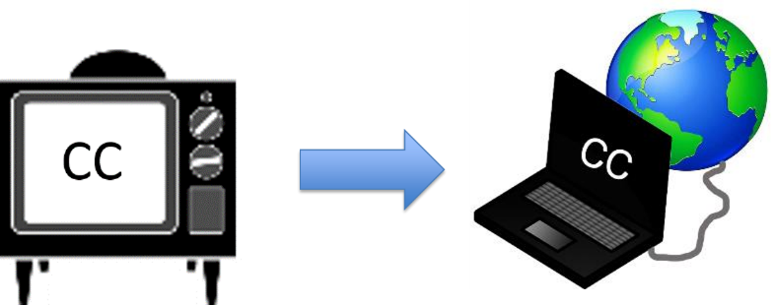
CVAA and Broadcast Video

Slide 9
CVAA
Twenty-First Century Communications and Video Accessibility Act – signed into Law Oct. 8, 2010
Updates federal communications law to increase the access of persons with disabilities to modern communications
Title I: addresses communications access to make products and services using Broadband fully accessible to people with disabilities
Title II: Makes it easier for people with disabilities to view video programming on television and the Internet

Slide 10
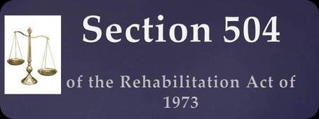
Section 504
A civil rights law to prohibit discrimination on the basis of disability in programs and activities, public and private, that receive federal financial assistance.

Slide 11

Section 508 Refresh (ICT Refresh)
1998 Amendment to the United States Workforce Rehabilitation Act of 1973, a federal law mandating that all electronic and information technology developed, procured, maintained, or used by the federal government be accessible to people with disabilities.

Slide 12

Section 508 Refresh Continued…
Section 508 of the Rehabilitation Act, as amended in 1998
Section 508 Refresh (ICT Refresh)
  U.S. Access Board Final Rule published Jan. 18, 2017
Compliance Date/Safe Harbor Provision
  Comply by Jan. 18, 2018
  Safe Harbor: Legacy ICT that has not been altered after compliance date

Slide 13

Section 255
Requires telecommunications products and services to be accessible to people with disabilities

Slide 14

Web Content Accessibility Guidelines (WCAG) 2.0
International Guidelines or Best Practices
World Wide Web Consortium (W3C)
  Web Accessibility Initiative (WAI)
Section 508 Refresh, as written
  “Incorporates by Reference” WCAG 2.0 Levels A and AA

Slide 15

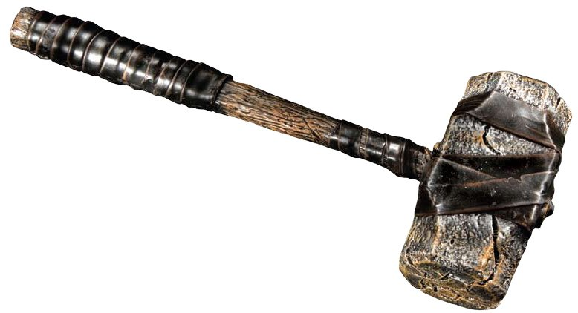
LEGAL
Settlements

Slide 16
Recent DOJ Settlements
    H&R Block (March, 2014)
    Peabod Groceries (Nov., 2014)
    edX (April, 2015)
    Carnival’s Cruise Ships (July, 2015)

Slide 17

Overview of DOJ Settlements
High Profile Settlements
Requirements
  WCAG 2.0 (Level AA) Applied
  Web Accessibility, which includes captioning
  Mobile Accessibility
  Appoint Web Accessibility Coordinator
  Adopt Web Accessibility Policy

Slide 18
Assistive Technology (AT) and Web-based Environments

Slide 19
Addressing the Needs of
People with Disabilities
Auditory
Cognitive and Neurological
Physical
Speech
Visual

Slide 20

Premier Literacy Suite
Text-to-Speech software
Post writing to “cloud applications”
Scan and read documents
Integrated Dictionary
Create study notes

Slide 21

Speech Recognition Software
Turn spoken words into text
Connect with the timing of your thoughts
Dictation speed 70 to 100 words per minute

Slide 22
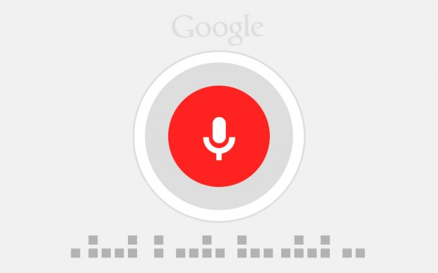

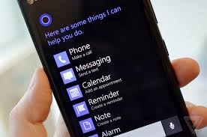
Speech-to-Text
      Siri (Apple)
      Google Now (Google)
      Cortana (Microsoft)

Slide 23


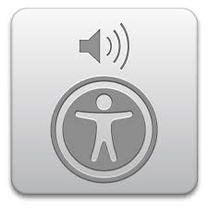

Text-to-Speech
      JAWS
      NVDA
      Window-Eyes
      VoiceOver (Mac)
      VoiceOver (iOS)
      TalkBack for Android

Slide 24
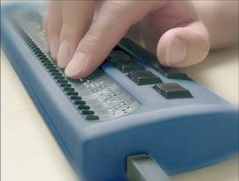
Refreshable Braille Displays
      Refreshable Braille Displays

Slide 25
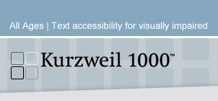


Optical Character Recognition
Open Book
Kurzweil 1000
Kurzweil 3000
Text Cloner Pro

Slide 26

AT Solutions for People with Low Vision
Screen Magnification Programs
Video Magnifiers
Portable Video Magnifiers
Video Magnifier Apps

Slide 27

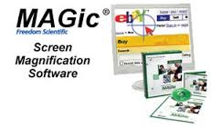
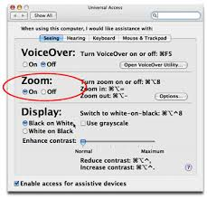
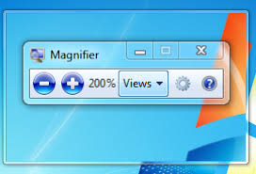
Screen Magnification Programs
MAGic
ZoomText
Windows Magnifier
Mac Zoom
Zoom and Magnifier (iOS & Android)

Slide 28
Demonstration:
What Does Web Accessibility Look, Feel and Sound Like?

Slide 29
WCAG 2.0

Slide 30
P.O.U.R. Websites: What makes them work?
WCAG 2.0
P.
Perceivable
O.
Operable
U.
Understandable
R.
Robust

Slide 31
Breakdown of P.O.U.R.
Perceivable - Information and user interface components presentable to users in ways they can perceive.
  (not invisible to all of their senses)
Operable - User interface components and navigation must be operable.
  able to operate the interface
Understandable - Information and the operation of user interface must be understandable.
  understand the information as well as the operation of the user interface
Robust - interpreted reliably by a wide variety of user agents, including assistive technologies.
  access content as technologies advance (as technologies and user agents evolve, the content should remain accessible)

Slide 32
Color Contrast
Difference between foreground and background colors
4.5:1 for normal-size text
3:1 for large text
Colour Contrast Analyzer by Paciello Group is one solution

Slide 33
Alternative Text
Alternative text to images, including the logo and any images that convey meaningful information and functionality
Allows people who are blind and rely on screen readers to better understand and navigate through the contents of a page
Differentiate between functional and aesthetic images

Slide 34
Effectively Labeled Links
Contextual Links
Non-Duplicate Links
Avoid “Read More” and “Click Here”
Also improves SEO

Slide 35
Effectively Use of Headings
Use Headings for Structure, NOT Style
<H1>, <H2>, <H3>, <H4>, <H5>, <H6>
Typically webpages should have one <H1>
They should follow a logical, hierarchical structure

Slide 36
Keyboard Access
When Testing, Let That Mouse Go!!!
Benefits:
  People who are blind relying solely on the keyboard
  People who have loss of fine motor skills
  People relying on peripheral devices
  People using the keyboard for efficiency over the mouse

Slide 37
Visual Focus
When Testing, Let That Mouse Go!!!
Benefits:
  People who are blind relying solely on the keyboard
  People who have loss of fine motor skills
  People relying on peripheral devices
  People using the keyboard for efficiency over the mouse

Slide 38
Page Titles
Allow users to know which page has focus
First piece of information read by screen readers
Beneficial for people with cognitive disabilities, which include short-term memory and reading disabilities

Slide 39
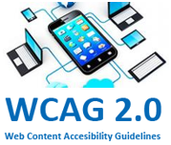
Mobile Accessibility and WCAG 2.0
Mobile Accessibility Mapped to P.O.U.R.
Designed to be forward looking
Some aspects it couldn’t anticipate

Slide 40
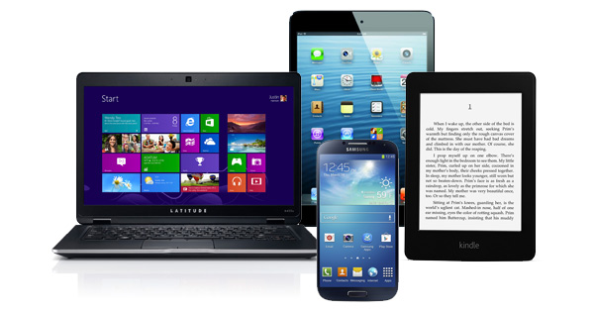
More than Just Phones & Tablets
Car interfaces
Videogame controllers
Smart watches
Emerging Markets

Slide 41

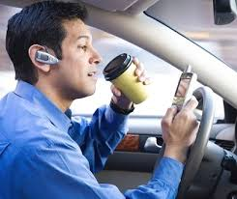
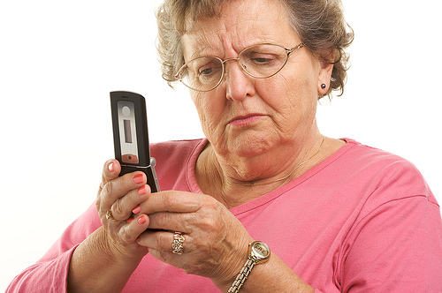

Mobile More Important Than Ever
Noisy Spaces
Using One Hand
Outdoor use in bright light
Small-sized touchscreens
Multitasking-Driving or Walking
All Ages Using Mobile

Slide 42
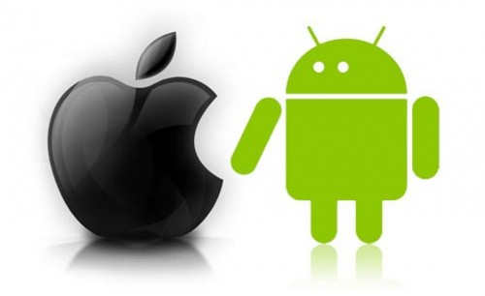
Testing with Mobile Devices
Use Latest Operating System when Possible
Apple: Latest iOS using smartphone and tablet
Android: Pair Google’s Nexus with Latest OS

Slide 43

Accessibility Checking
Automated Tools
Semi-Automated Tools and Toolbars
Manual Checks
Human Testing
All of the above

Slide 44
Web Accessibility Resources
WCAG 2.0 Checklist
W3C Easy Checks – A First Review of Web Accessibility
  Includes Before-and-After Demo for checking website accessibility
Web Accessibility Group at AMAC (Listserv and WAG Monthly Meetings online)
AccessGA at AMAC
Colour Contrast Analyser
WAVE (Check single web pages)

Slide 45
Questions???

